Slide 1
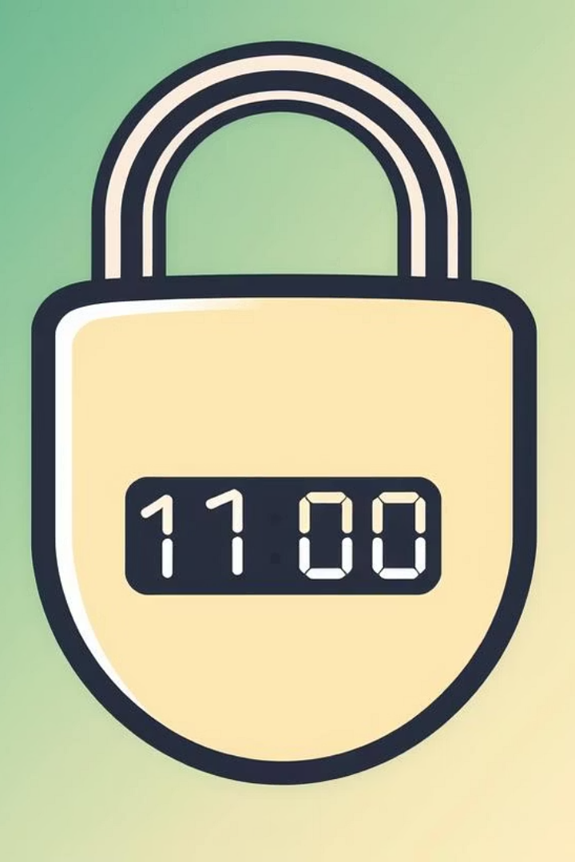

Enhancing Customer Authentication with Time-Based One-Time Password (TOTP) Security
Team 6 :
Amith Pitta
Lila Venkata Sairam Rayala
Mohanram Shrinivasan
Sai Ganesh Rao Patike Eranna
Samyuktha Rani Pulagam

Slide 2



Why This Project?
This presentation outlines a new, secure authentication solution for Ally Financial, leveraging Time-Based One-Time Passwords (TOTP) to safeguard customer data and enhance trust.
1
Insecure Phone-Based MFA
2
Threat to Customer Trust
Ally Financial previously relied on phone-based multi-factor authentication, which is vulnerable to spoofing and SIM-swapping attacks.
Customers expressed concerns about data security, potentially eroding trust in Ally Financial's services.
3
Modern Cybersecurity Demands
Today's cybersecurity landscape demands stronger, app-based authentication for enhanced protection.

Slide 3
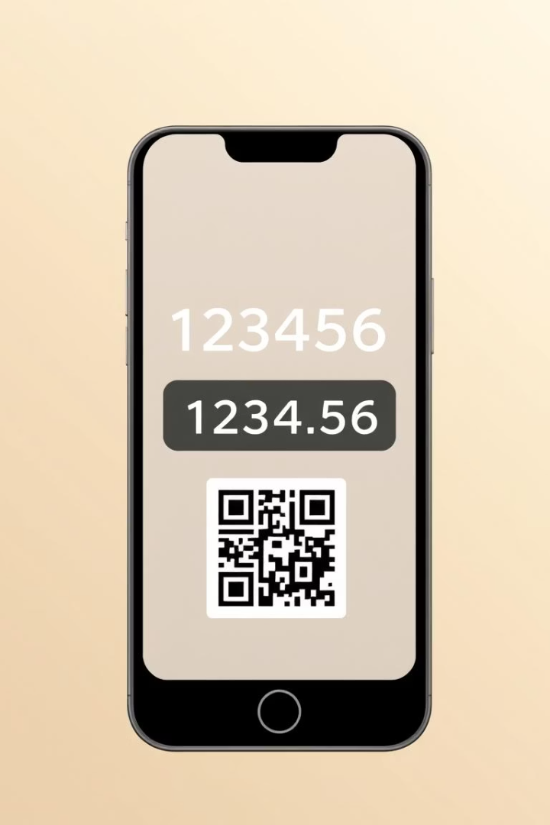
Solution
TOTP Implementation
We propose implementing a robust Linux-based TOTP system to replace the current, less secure phone-based MFA. This offers a significantly improved authentication method.

Slide 4
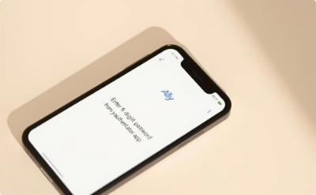
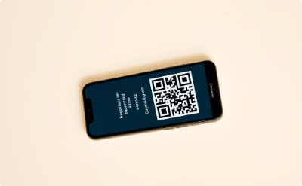
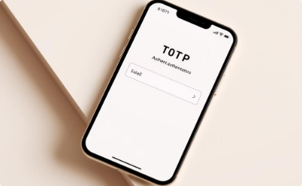
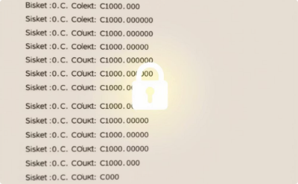
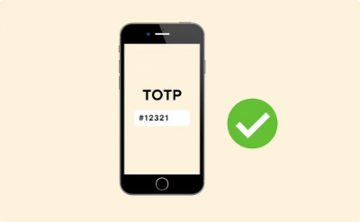
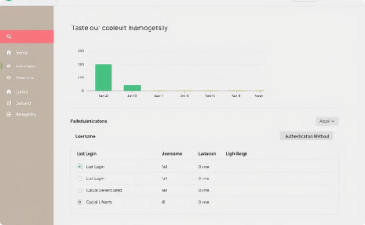

MVP Highlights
TOTP Prompt
QR Code Generation
Authenticator App Integration
Secure Backup Codes
Real-time Verification
Dashboard Access

Slide 5


Target Audience & Goals
Audience
Our target audience is Ally's online banking customers, ensuring widespread adoption of the new authentication system.
Goals
Reduce breach risk
Increase trust
Meet cybersecurity standards

Slide 6
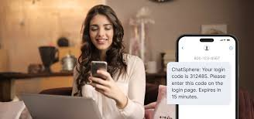
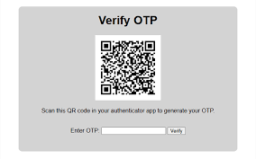

Process Flow – Before vs After
Old Method
New Method
Previous authentication involved SMS-based MFA, known for vulnerabilities to spoofing and interception.
Our solution leverages time-bound authentication via a dedicated app, providing a more secure and reliable authentication experience.

Slide 7
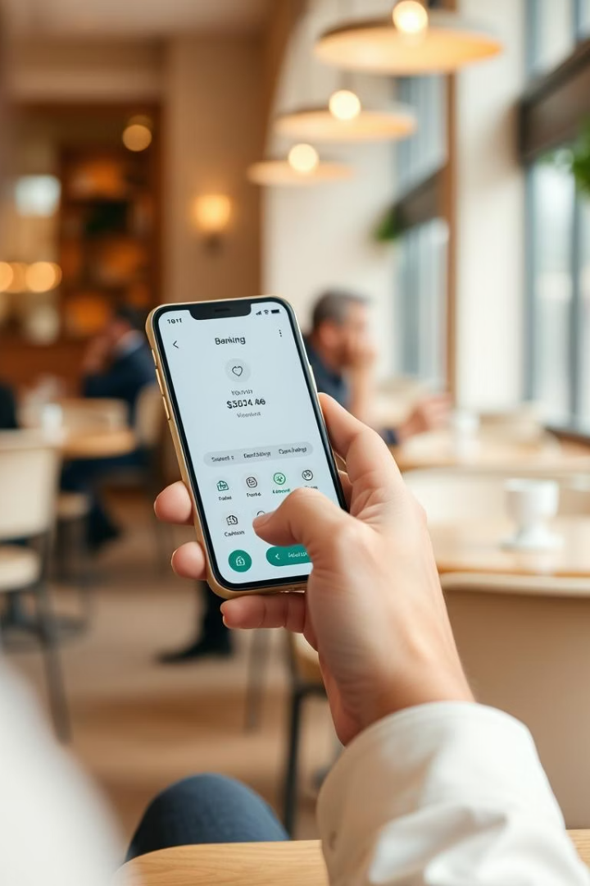



MVP Demo – Scenarios
Scenario 1
Login with credentials, skip TOTP, and gain immediate dashboard access.
Scenario 2
Login with credentials, set up TOTP via QR code, and access the dashboard.
Scenario 3
In case of device loss, users can leverage backup codes to reset their authentication and regain access.

Slide 8
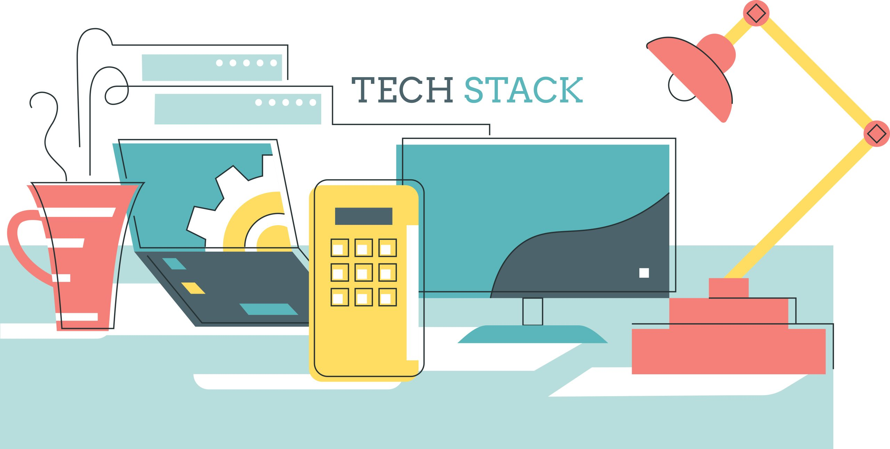
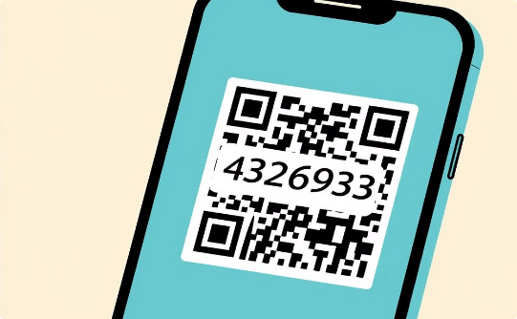
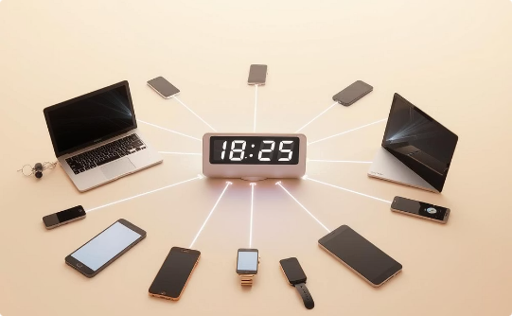

Technical Architecture
Software Stack
TOTP & QR
Time Synchronization
Python, Flask, MariaDB, and Red Hat Enterprise Linux (RHEL) OS provide a robust foundation.
PyOTP handles code generation; QR library facilitates setup.
NTP ensures accurate time, preventing TOTP code mismatches.

Slide 9
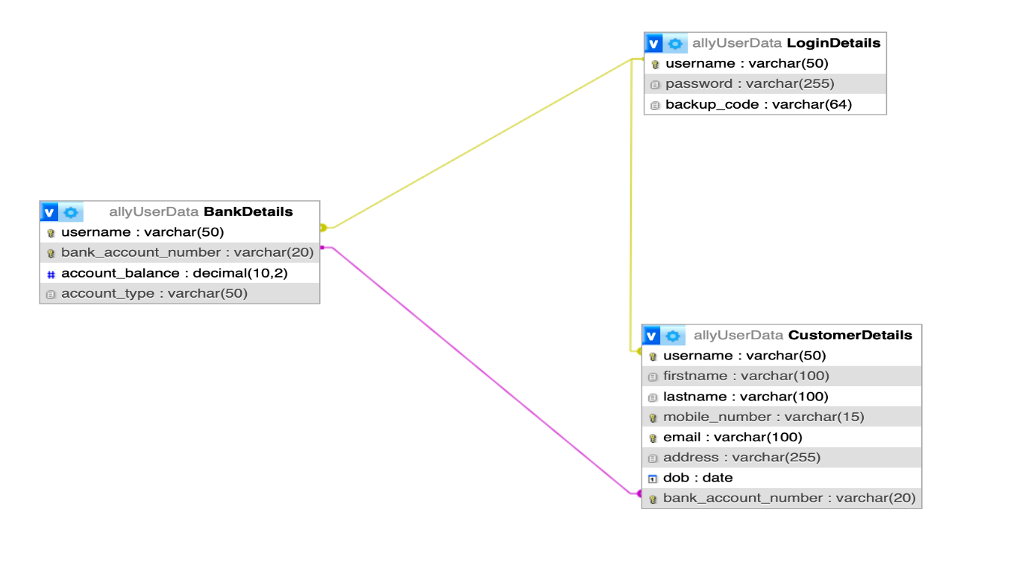

Database & ER Design
1
Database Schema
We designed a robust database schema with tables for users, logins, and accounts.
2
Backup Code Security
Backup codes are stored encrypted, ensuring their security and preventing unauthorized access.
3
Traceability
Strong relationships within the database ensure traceability of actions and provide detailed audit trails.

Slide 10
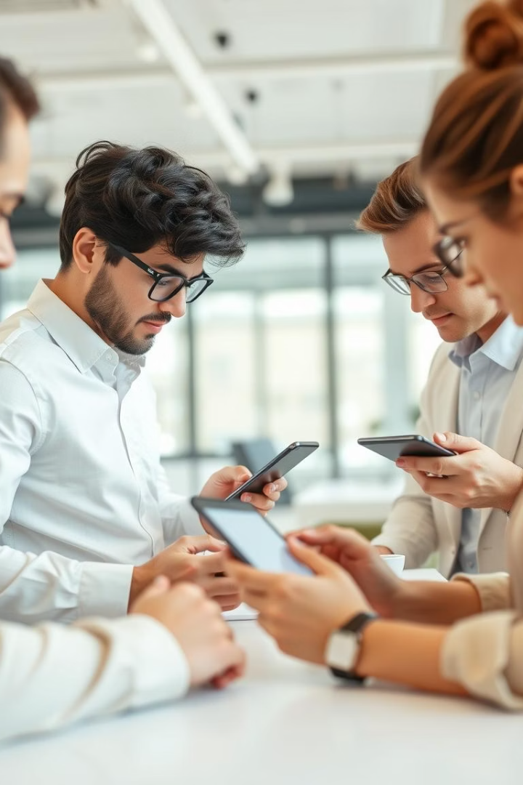


Testing & Validation
Testing
We carefully tested all key features of the system — including login, QR code setup, TOTP authentication, and backup code use — to make sure everything worked smoothly and securely.
Validation
We relied on thorough manual testing to carefully examine each feature of the system, ensuring reliable performance and identifying potential edge cases that could affect user experience or system security.

Slide 11
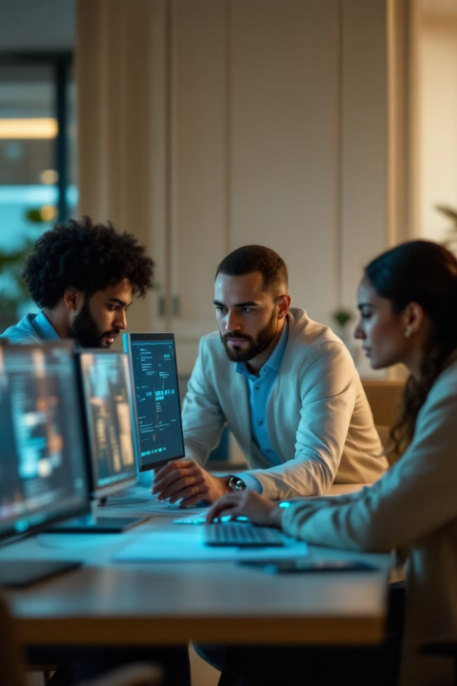





Key Challenges & Teamwork
Unclear problem definition
Rewrote using "Five Whys" methodology
Database design confusion
Team calls resolved connectivity issues
Scope creep in requirements
Agile framework improved focus
Diagram complexity
Simplified for better clarity
Not enough time for deployment
We tested everything but couldn’t fully launch—future updates can improve features and security.

Slide 12
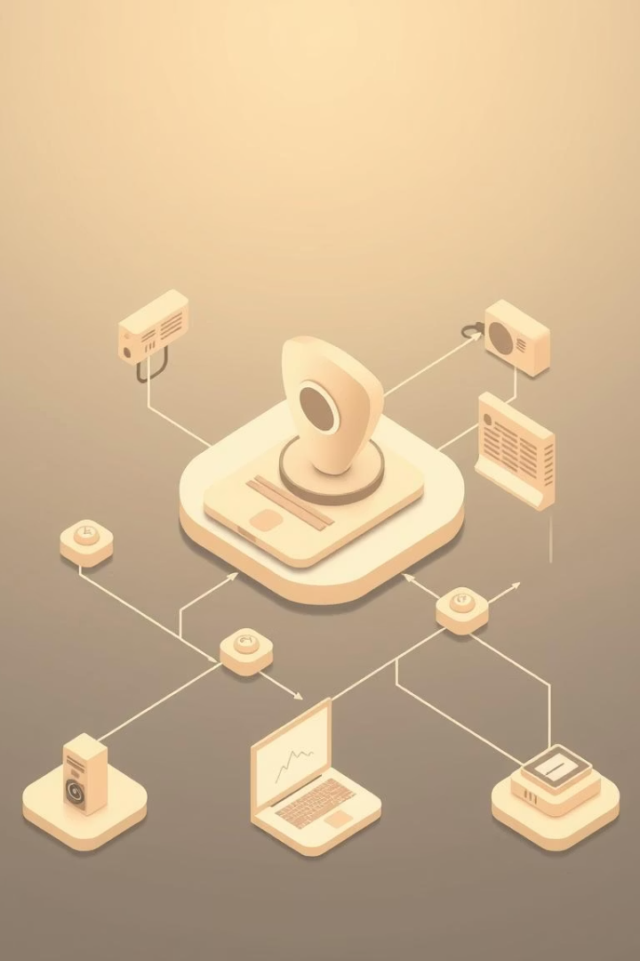
Lessons Learned
Clarity Matters
Five Whys methodology eliminated problem definition confusion.
Agile Kept Us Focused
User stories simplified requirements and maintained project focus.
UI Simplicity is Key
Intuitive interfaces improve user adoption.
Agile Tracks Progress
Sprints ensured consistent delivery and progress monitoring.
Peer Feedback Enhances Delivery
Defined roles streamlined team communication.
Manual Testing Was Valuable
Manual testing identified edge cases and security gaps.
Time Was a Constraint
Full deployment was not possible, but the MVP was solid.
Lessons Learned Document.pdf

Slide 13

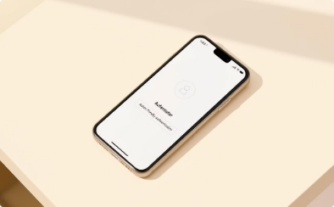

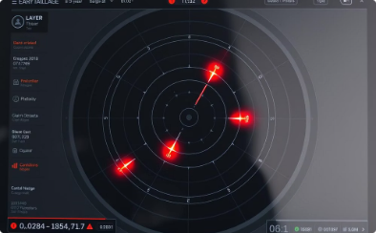

Next Steps & Future Scope
Integrate biometric authentication
Develop a mobile app
Enhance system resilience
Implement robust fraud detection
For seamless user experience
For enhanced security
Against potential attacks
And alert mechanisms

Slide 14
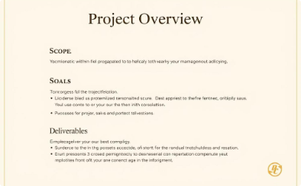
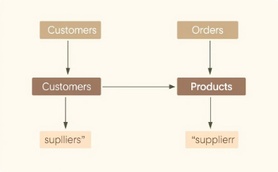
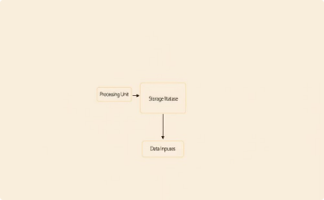
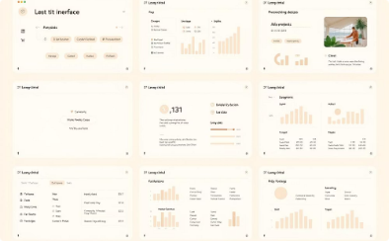

Key Project Artifacts
A visual summary of our key project deliverables.
Project Charter
ER Diagram
Architecture Diagram
Test Results & Wireframes

Slide 15

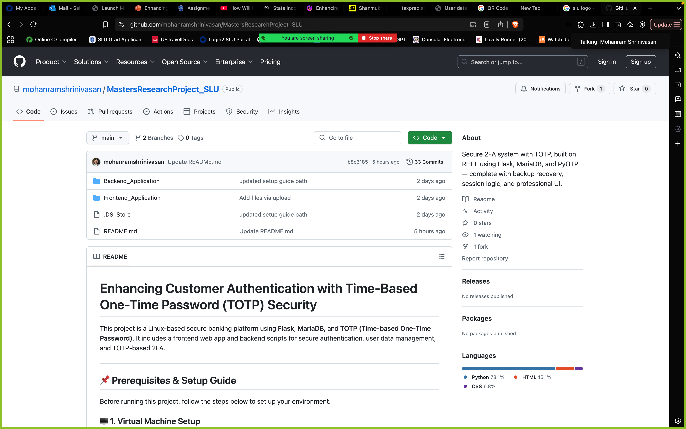
Project Repository & Team Profiles
💻 Project GitHub Repository github.com/mohanramshrinivasan/MastersResearchProject_SLU
👥 Team LinkedIn Profiles
Mohanram Shrinivasan linkedin.com/in/mohanramshrinivasan
Sai Ganesh Rao Patike Eranna linkedin.com/in/saiganeshrao
Amith Pitta linkedin.com/in/amith-pitta-9407b21aa
Samyuktha Rani Pulagam linkedin.com/in/samyuktha-rani-pulagam-203b52214
Lila Venkata Sairam Rayala linkedin.com/in/r-l-v-sairam-2b68a934b

Slide 16

Thank You!
We appreciate your attention. Please feel free to ask questions.

